Slide 1
Chapter 2

Slide 2
UNIT - 4 (16 hours)
Introduction to GPU: GPUs as Parallel Computers, Architecture of a modern GPU, Why More Speed or Parallelism, Parallel Programming Languages and Models Overarching Goals, Evolution of Graphics Pipelines; the Era of Fixed-Function Graphics Pipelines, Evolution of Programmable Real-Time Graphics, Unified Graphics and Computing Processors, GPGPU, An Intermediate Step, GPU Computing Scalable GPUs Recent Developments, Future Trends. Introduction to CUDA: Data Parallelism CUDA Program Structure, a Matrix-Matrix Multiplication Example.

Slide 3
Evolution of Graphics Pipelines; the Era of Fixed-Function Graphics Pipelines,
Graphics processing units (GPUs) are massively parallel numeric computing processors, programmed in C with extensions.
Understanding the graphics heritage illuminates the strengths and weaknesses of GPUs with respect to major computational patterns.
The history clarifies the rationale behind major architectural design decisions of modern programmable GPUs:
massive multithreading,
relatively small cache memories compared to caches of CPUs,
bandwidth-centric memory interface design.

Slide 4
Insights in the history provide the context for the future evolution.
Three dimensional (3D) graphics pipeline hardware evolved from large expensive systems of the early 1980s to small workstations and then PC accelerators in the mid to late 1990s.
During this period, the performance increased:
from 50 millionspixes to 1 billion pixels per second,
from 100,000 vertices to 10 million vertices per second.
This advancement was driven by market demand for high quality, real time graphics in computer applications.
The architecture evolved from a simple pipeline for drawing wire frame diagrams to a parallel design of several deep parallel pipelines capable of rendering the complex interactive imagery of 3D scenes.

Slide 5
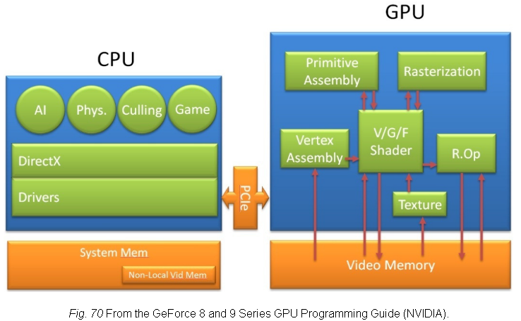
In the mean time, graphics processors became programmable.:In displaying images, the parts in the GPU are shown in fig

Slide 6
The surface of an object is drawn as a collection of triangles.
The Application Programming Interface (API) is a standardized layer of software that allows an application (e.g.: a game) to send commands to a graphics processing unit to draw objects on a display.
Examples of such APIs are DirectX and OpenGL. The host interface (the interface to the GPU) receives graphics commands and data from the CPU, communicates back the status and result data of the execution.

Slide 7
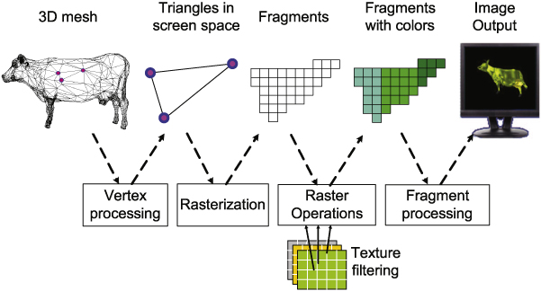

Slide 8
Era of fixed function Graphics Pipelines
CUDA - Fixed Functioning Graphics Pipelines kind of hardware was popular from the early 1980s to the late 1990s.
These were fixed-function pipelines that were configurable, but not programmable. Modern GPUs are shader-based and programmable.

Slide 9
The fixed-function pipeline does exactly what the name suggests; its functionality is fixed.
So, for example, if the pipeline contains a list of methods to rasterize geometry and shade pixels, that is pretty much it. You cannot add any more methods.

Slide 10
In modern GPUs, all the pipelines are generic, and can run any type of GPU assembler code. In recent time, the number of functions of the pipeline are many - they do vertex mapping, and color calculation for each pixel, they also support geometry shader (tessellation), and even compute shaders (where the parallel processor is used to do a non-graphics job).

Slide 11
Fixed function pipelines are limited in their capabilities, but are easy to design.
They are not used much in today’s graphics systems.
Instead, programmable pipelines using OpenGL or DirectX are the de-facto standards for modern GPUs.

Slide 12
A fixed-function NVIDIA GeForce graphics pipeline.
The CPU sends commands and data to the GPU host interface. Typically, the commands are given by application programs by calling an API function (from a list of many).
A specialized Direct Memory Access (DMA) hardware is used by the host interface to fasten the transfer of bulk data to and fro the graphics pipeline.

Slide 13
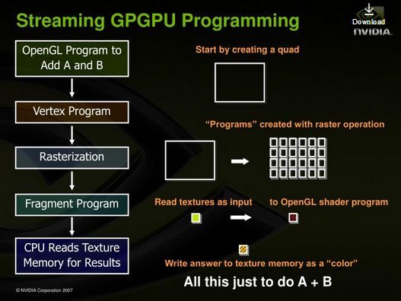

Slide 14
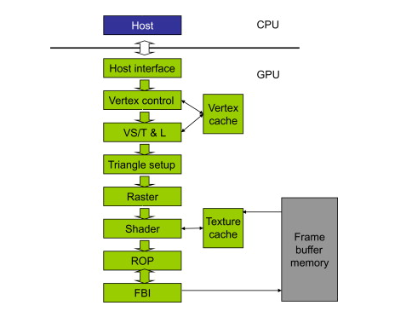

Slide 15
In the GeForce pipeline, the surface of an object is drawn as a collection of triangles (the GeForce pipeline has been designed to render triangles).
The finer the size of the triangle, the better the image quality (you can observe them in older games like the Tekken 3).

Slide 16
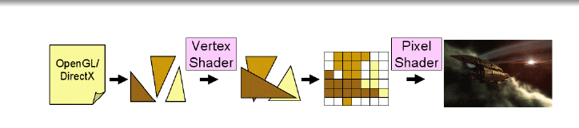
The vertex control stage receives parameterized triangle data from the host interface (which in-turn receives it from the CPU). Then comes the VT/T&;L stage.
It stands for Vertex Shading, Transform and Lighting. This stage transforms vertices and assigns each vertex values for some parameters, such as colors, texture coordinates, normals and tangents.
The pixel shader hardware does the shading (the vertex shader assigns a color value to each vertex, but coloring is done later).

Slide 17
The triangle setup stage is used to interpolate colors and other vertex parameters to those pixels that are touched by the triangle (the triangle setup stage actually determines the edge equations. It is the raster stage that interpolates).
The shader stage gives the pixel its final color. There are many methods to achieve this, apart form interpolations.
Some of them include texture mapping, per-pixel lighting, reflections, etc.

Slide 18
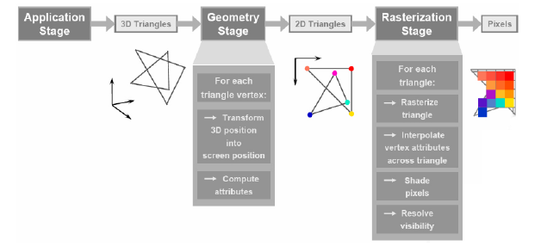

Slide 19
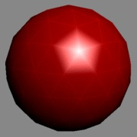
Shading Using Interpolation
It is basically assigning a color to each vertex of a triangle on the surface (represented by polygon meshes, in our case, the polygon is a triangle), and linearly interpolating for each pixel covered by the triangle.
There are many varieties to this, such as flat shading, Gouraud shading and Phong shading.

Slide 20
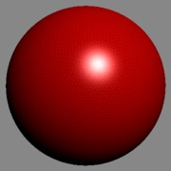
Let us now see shading using Gouraud shading. The triangle count is poor, and hence the poor performance of the specular highlight.
The same image rendered with a high triangle count

Slide 21
Per-pixel Lighting
In this technique, illumination for each pixel is calculated. This results in a better quality image than an image that is shaded using interpolation. Most modern video games use this technique for increased realism and level of detail.
The ROP stage (Raster Operation) is used to perform the final rasterization steps on pixels. For example, it blends the color of overlapping objects for transparency and anti-aliasing effects. It also determines what pixels are occluded in a scene (a pixel is occluded when it is hidden by some other pixel in the image). Occluded pixels are simply discarded.
Reads and writes from the display buffer memory are managed by the last stage, that is, the frame buffer interface.

Slide 22
The Era of Fixed function Graphics Pipelines
Graphics processing units (GPUs) are massively parallel numeric computing processors, programmed in C with extensions.
Understanding the graphics heritage illuminates the strengths and weaknesses of GPUs with respect to major computational patterns.

Slide 23
The history clarifies the rationale behind major architectural design decisions of modern programmable GPUs:
massive multithreading,
relatively small cache memories compared to caches of CPUs,
bandwidth-centric memory interface design.

Slide 24
History of the GPUs the basic graphics pipeline stages have evolved from purely hardwired implementations to processor-like programmable unit implementations that have revolutionized the way GPUs are used.

Slide 25
One such evolution was the introduction of programmable processors given below :
Vertex processor: Their purpose is to transform each input vertices individual coordinates to a global coordinate system. They also determine the depth value of each vertex.
▪ Geometry processor: They add/remove vertices from a 3D mesh and are responsible for geometric transformations on the input vertices/triangles.
▪ Pixel/Fragment processor: They are responsible for calculating the color of each individual pixel as well as to add effect such as lighting, shading and toning.

Slide 26
These programmable processors replaced most of the fixed-function stages in the graphics pipeline.
These processors could be programmed with small programs called shader programs. Hence we have vertex, geometry, and pixel shaders, a type of program for each processor.
The introduction of this programmable shader model allowed some GPU parts to be programmed according to a specified instruction set.

Slide 27
Vertex shader programs map the positions of triangle vertices onto the screen, altering their position, color, or orientation.
A vertex shader thread reads a vertex position (x,y,z,w)(x,y,z,w) and computes its position on screen.
Geometry shader programs operate on primitives defined by multiple vertices, changing them or generating additional primitives.
Vertex shader programs and geometry shader programs execute on the vertex shader (VS/T & L) stage of the graphics pipeline.

Slide 28
The shader stage in Figure 2.1 determines the final color of each pixel. This can be generated as a combined effect of many techniques: interpolation of vertex colors, texture mapping, per-pixel lighting mathematics, reflections, and more. Many effects that make the rendered images more realistic are incorporated in the shader stage.

Slide 29
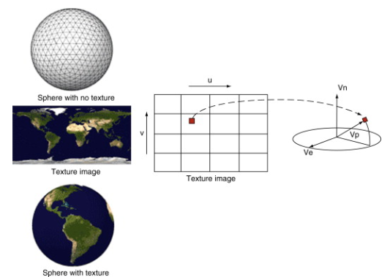
Figure 2.2 illustrates texture mapping, one of the shader stage functionalities. It shows an example in which a world map texture is mapped onto a sphere object.
Note that the sphere object is described as a large collection of triangles.
Although the shader stage needs to perform only a small number of coordinate transform calculations to identify the exact coordinates of the texture point that will be painted on a point in one of the triangles that describes the sphere object, the sheer number of pixels covered by the image requires the shader stage to perform a very large number of coordinate transforms for each frame.

Slide 30
The ROP (raster operation) stage in Figure 2.2 performs the final raster operations on the pixels.
It performs color raster operations that blend the color of overlapping/adjacent objects for transparency and anti-aliasing effects.
It also determines the visible objects for a given viewpoint and discards the occluded pixels.
A pixel becomes occluded when it is blocked by pixels from other objects according to the given viewpoint. partly in another object or the background

Slide 31
. Forcing these pixels to assume the color of one of the objects introduces distortion into the edges of the objects. The anti-aliasing operation gives each pixel a color that is blended, or linearly combined, from the colors of all the objects and background that partly overlap the pixel. The contribution of each object to the color of the pixel is to the amount of the pixel that the object overlaps.

